Slide 1
Blindfolded Evaluation of Decision Trees
Homomorphic Encryption

Slide 2
Original Paper from :
Asma Aloufi, Peizhao Hu, Harry W. H. Wong, Sherman Chow
Presenters:
Karan Naidu
Pranav Vardia

Slide 3
Introduction
In this implementation we have considered client-server architecture.
Client sends the encrypted inputs to the server, who then evaluates and sends back the final encrypted result.

Slide 4
Evaluation
Secure Comparison protocol
Given encrypted x and y, returns enc(1) if x < y.
b = (x_{l-1} < y_{l-1}) or ((x_{l-1} = y_{l-1}) and (x_{l-2} < y_{l-2})) .....or ((x_{l-1} = y_{l-1})(x_{l-2} = y_{l-2})....(x₁ = y₁)(x₀ < y₀))
This encrypted bit b is obtained for each decision node.

Slide 5
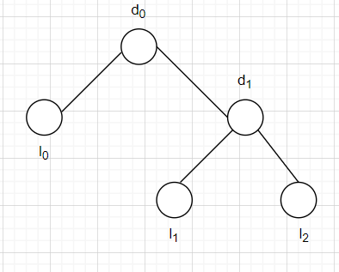
Evaluation
Polynomial evaluation
Given this DT. Evaluation of d₀ and d₁ returns b₀ and b₁.
Final output is ‘OR’ of all possible paths.
v = b₀l₀ + (1-b₀)(b₁l₁ + (1-b₁)l₂)

Slide 6
Implementation
Implemented in Two-party Setting
Python Language used
Focus on Sec Comp Protocol
Multi-Key Scheme not used due to no available libraries and resources
Decision Tree training implemented using Pandas and Sklearn libraries

Slide 7
Implementation
Encryptions and Computations done using PyFhel library.
PyFhel library uses HeLib library as a backend.
Allows operations such as addition, multiplication on vectors
Run on Intel Dual Core i5, 8 GB RAM, and 2.2 GHz system and tested

Slide 8
Procedure
Decision Tree Model Trained by Model Owner
Tested on Iris Dataset
Obtain Thresholds of divide and the features on which it is divided
Perform bit encryption of these thresholds and using PyFhel
Client knows the features
Client encrypts the query and sends it to Model Owner

Slide 9
Procedure
Server performs SecComp at each node of split
Results are sent to client for decryption
Client Decrypts the secret

Slide 10
Conclusion and Future Work
Code can be found at Github Repo : https://github.com/AlwaysHumble/random-forest-homo-enc/tree/master
Future Work includes multi-party implementation
Faster implementation for more depth of tree
Accommodating Floating-point decimals for comparison by CKKS tools in Python.

Slide 11

Thank you!

